Slide 1
Pedestrian detection
Using CreateML

Slide 2
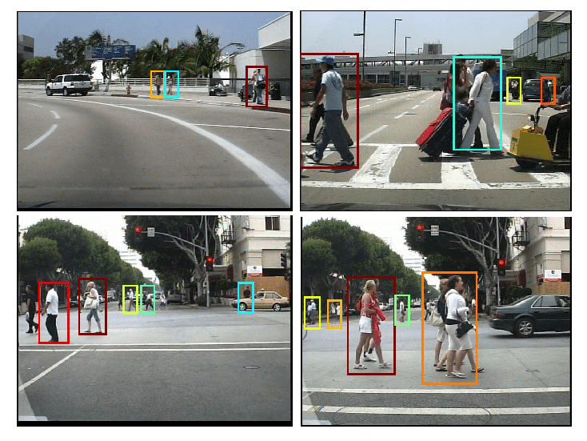
What does it do?

Slide 3

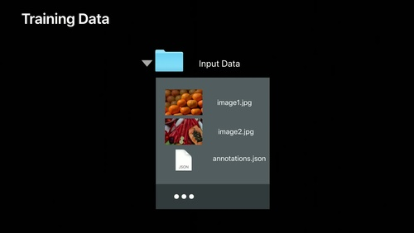
How does CreateML work?

Slide 4
Results were... interesing
 | CALTECH |  | JAAD
Data Set Size | Small | Big | Small | Big
Training | 95% | 81% | 91% | 65%
Validation | 96% | 83% | 88% | 65%
Testing | 13% | 3% | 45% | 35%

Slide 5
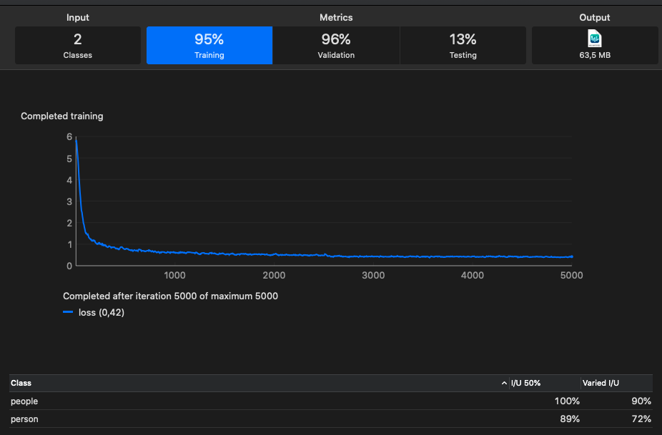
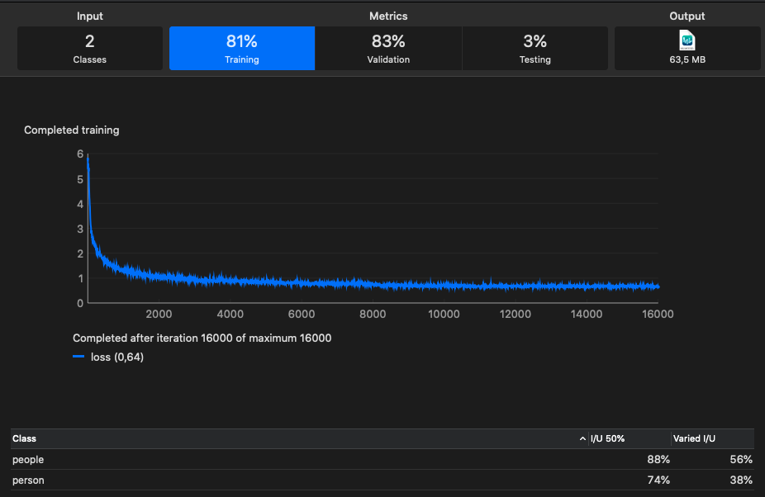
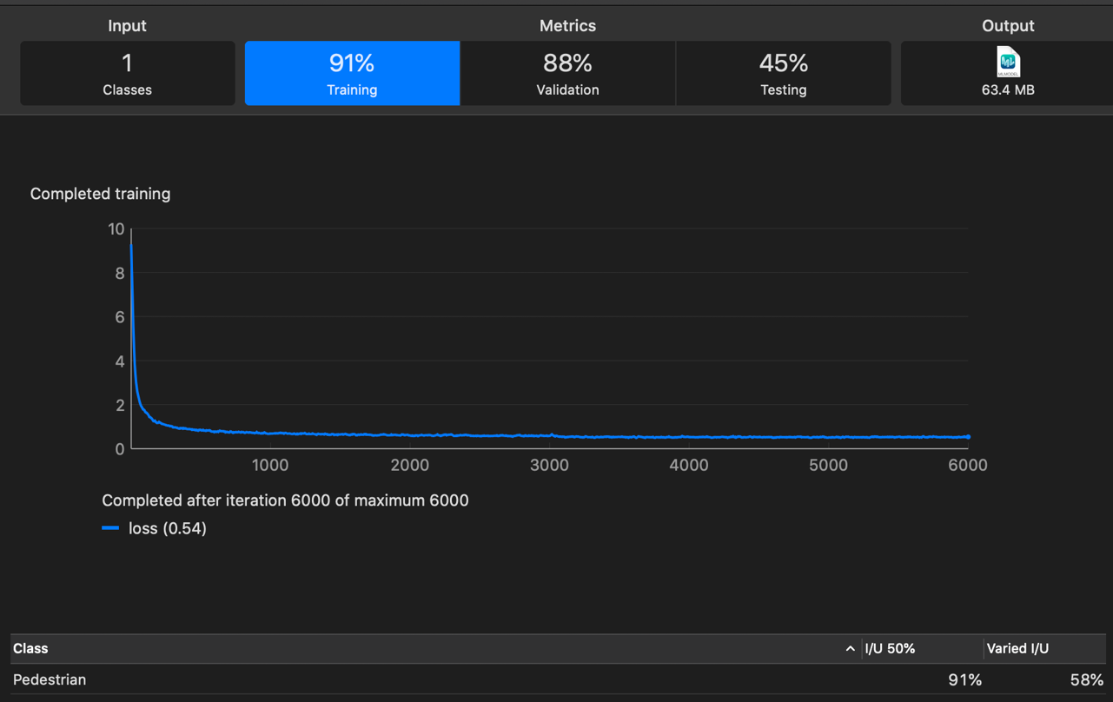
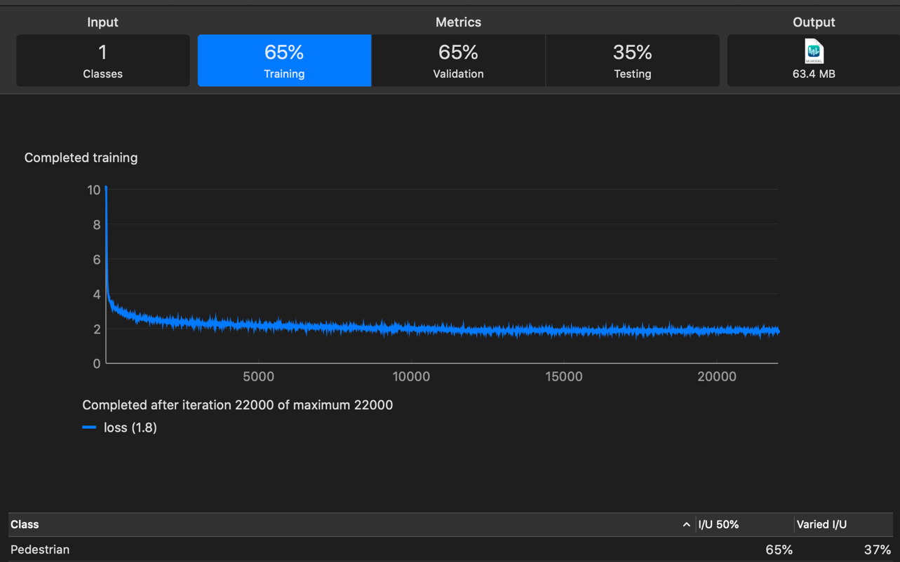
JAAD
CALTECH

Slide 6
Demo

Slide 7

Conclusions

